Slide 1
PRESENTED BY: Dr Sonika Bodhi Reader Dept. of Periodontology
RUNGTA COLLEGE OF DENTAL SCIENCES AND RESEARCH,BHILAI
OSSEOINTEGRATION
PRESENTED BY:
Dr Sonika Bodhi
Reader
Dept. of Periodontology

Slide 2
SPECIFIC LEARNING OBJECTIVES
Core areas | Domain | Category
Inroduction | Affective | Desire to know
Historical background | Cognitive | Nice to know
Implant bone interface | Cognitive | Nice to know
Definition | Cognitive | Must to know
Bonding between implant and the bone | Cognitive | Must to know
Process of osseointegration | Cognitive | Must to know
Clinical biomechanical assessment for osseointegration | Cognitive | Nice to know
Factors affecting osseointegration | Cognitive | Must to know

Slide 3
CONTENTS
Inroduction
Historical background
Implant bone interface
Definition
Bonding between implant and the bone
Process of osseointegration
Clinical biomechanical assessment for osseointegration
Factors affecting osseointegration
Summary

Slide 4
Per Ingvar Brånemark
Professor at the institute for Applied Biotechology, University of Goteborg, Sweden
SERENDIPITOUS FINDING
1950 – research was being conducted at Cambridge university to study the blood flow in vivo they used the chamber of titanium
1952- Per Ingvar Brånemark, while studying bone healing and regeneration, adopted titanium chamber for use in the rabbit femur
Following several months , when he wanted to retrieve these chambers, he found that he was unable to remove them
He observed that bone had grown into close proximity with the titanium that is effectively adhered to metal

Slide 5
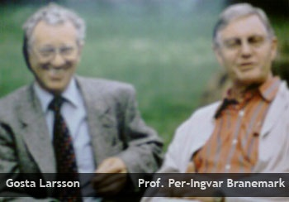
1965- first human volunteer was‘ Gosta Larsson’ in the lower anterior region which was successful
Next 14 years was the golden era of implantology , were numerous studies published by Brånemark.

Slide 6
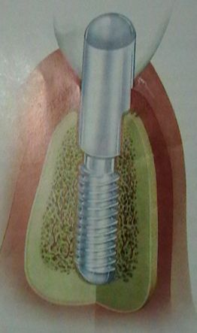
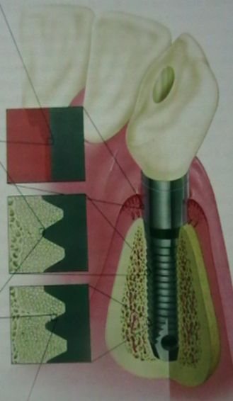
Implant bone interface
Vs
Fibro-osseointegration
Osseointegration

Slide 7
FIBRO- OSSEOINTEGRATION
Tissue to implant contact with the healthy dense collagenous tissue between the bone and the implant, which acts as an osteogenic membrane
Weiss (1980), Linkow and James
( 1975)

Slide 8
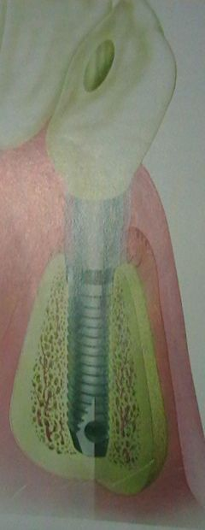
OSSEOINTEGRATION
“Os” – bone
“Integration”-state of being combined in to a whole
Term coined by Brånemark
Schroeder ( functional ankylosis) – first demostrate it histologically
Other terms- micro interlock

Slide 9
Definitions
Branemark. P. I. (1969, 1986)
“Osseointegration is defined as the direct structural and
functional connection between ordered, living bone and the surface of a load-bearing implant without intervening soft tissues ”- histological definition
American Academy of Implant dentistry (1986)
“Contact established without interposition of non- bone tissue between normal remodeled bone and an implant to and within the bone tissue”

Slide 10
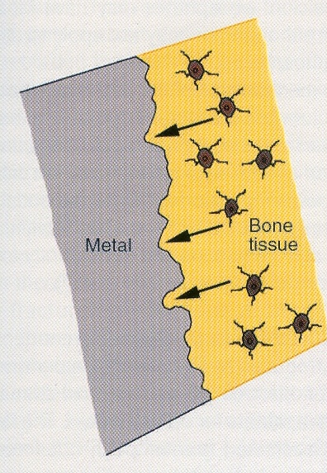
Bonding between implant and the bone
Biomechanical bonding
Bone may grow in to irregularities of implant and with time establish an interlocking
Described as regular osseointegration-
Initial stability is achieved by the threaded geometry
Secondary stability through the ingrowth of bone a relatively time consuming procedure

Slide 11
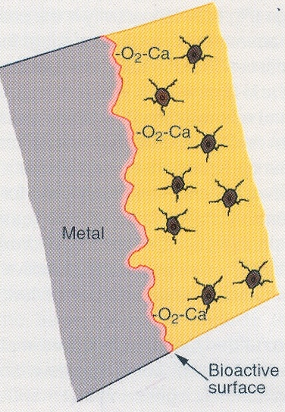
Biochemical bonding (osseocoalescence)
Bone may establish instantaneous chemical bond across the interface
Various ions, such as calcium, magnesium, or fluoride to the surface of the implant or ceramic materials such as hydroxyapatite, capable of biochemical bonding
Bond act immediately and create implant stability

Slide 12
Process of Osseointegration

Slide 13
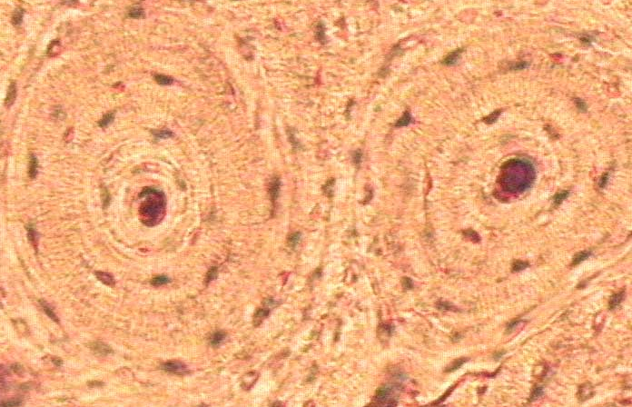
In areas of cortical bone…..
Primary stability is obtained by congruency and press fitting which leads to direct bone- implant contact
Press fitting causes local overload, with plastic deformation of lamellae, and even fissures and micro cracks
At 3 months, it is partially or completely filled by lamellar bone
Cortical remodeling- remodeling is the dominant mechanism in stage 3, finally replaces avascular areas by mature living bone by 60- 70 % in 15 months

Slide 14
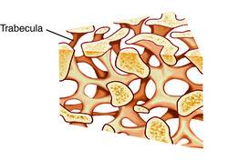
In the cancellous bone…
Cancellous bone contributes much less to primary stability Volume density is about 20 -25% (vs. cortical bone 80-90%)
A large compartment of implant surface is exposed to bone marrow, with its ample vascularity, and abundance of precursor cells for osteoblasts
Secondary bone- implant contact is achieved by bridging the intertrabecular marrow spaces
Free end of trabeculae or edges and threads of the implant serves as a bridgehead- this is reinforced by lamellar bone

Slide 15
Time course of interface development for an endosseous implant in human cortical bone
Remodeling maturation
Stage I-
6 weeks, woven callus
Stage 2
18 weeks
Lamellar compaction
Stage 3
18-24 weeks
Interface
Remodeling
Stage 4
54 weeks
Compact
maturation
Surface modeling
Roberts 1998

Slide 16
Initial bone healing
The osseointegration process observed after implant placement can be compared to bone fracture healing
Implant site osteotomy preparation initiates a cascade of events involving inflammatory reaction, bone resorption, release of growth factors, chemotaxis of osteoprogenitor cells to the site
Osteocalcin modulate apatite crystal growth

Slide 17
A certain immobility of the implant surface toward the bone should be maintained.
A mild inflammatory response, as triggered by movements or appropriate electrical stimuli, may enhance the bone-healing response, but above a certain threshold, this is detrimental (moderate & sever inflammation are detrimental).
It has been reported that when micromovements at the interface exceed 150 mm, differentiation to osteoblasts will not occur; rather, a fibrous scar tissue is laid down between the bone and implant surface

Slide 18
If the neighboring bone has been overheated or crushed during drilling, necrotic area will prevent ingrowth of stem cells, and a scar formation or sequestered formation will result.
The critical temperature for bone cells is as low as 47° C at an exposure time of 1 minute. This corresponds to the denaturing temperature of alkaline phosphatase, the main bone cell enzyme
The limited damage to bone tissue must be cleared up by osteoclasts before the bone healing.

Slide 19
Osteoclasts can resorb bone at a pace of 50 to 100 mm per day.
There is a coupling between bone apposition and bone resorption. The preosteoblasts, derived from the invading primary mesenchymal cells, depend on a favorable oxidation-reduction (redox) potential of the environment. Thus a proper vascular supply and oxygen tension are needed

Slide 20
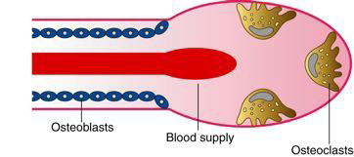

Slide 21
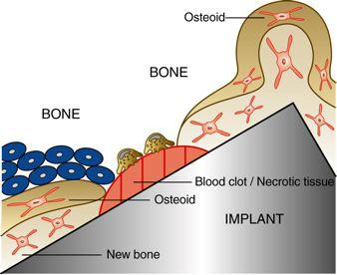

Slide 22
First, woven bone is quickly formed in the gap between the implant and the bone.
After several months, this is progressively replaced by lamellar bone under the load stimulation.
A steady state is reached after about 1½ years. Often, for oral implants, occlusal load is allowed as soon as 2 to 3 months, while mostly woven bone is present.

Slide 23
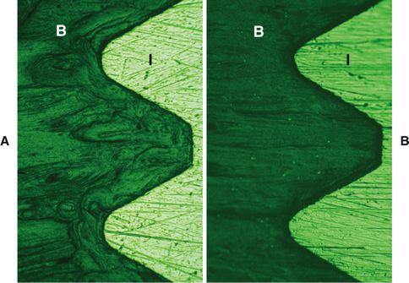

Slide 24
Woven bone grows fast, up to 100 μm per day, and in all directions.
It is characterized by a random orientation of its collagen fibrils, high cellularity, and limited degree of mineralization.
Limited mineralization means that the bone's biomechanical capacity is poor, and thus occlusal load should be controlled.

Slide 25
After 1 to 2 months, under the effect of load, the woven bone surrounding the implant will slowly transform into lamellar bone.
Parallel layers of collagen fibrils characterize the latter, each with their own orientation, which explains the typical polarized light aspect.
Contrary to the fast growing woven bone, lamellar bone apposition occurs at a slow pace of a few microns per day.

Slide 26
After 18 months a steady state is achieved where resorption and deposition of the lamellar bone is in equilibrium
Once the bone-to-implant interface has reached a steady state, it can maintain itself over decades, as histologically ascertained from implants retrieved because of hardware fractures.
At the light microscopic level, an intimate bone-to-implant contact has been reported extensively

Slide 27
Bone remodelling and function
Both the primary stability and the secondary stability of an implant determine its success and survival.
Primary stability is that achieved at surgery. It depends on the bone quality and available volume, the relation between drill and implant diameter, and the implant geometry.
The quantity of bone-to-implant contact area is a well-known parameter.

Slide 28
Little is known about the fate of the bone-to-implant interface during the first days and weeks after surgery.
During the first weeks for one-stage implants, decreased rigidity can be observed.
Subsequently, rigidity increases and continues to increase for years.
Thus, when a prosthesis is installed immediately (in 1 day) or early (in 1-2 weeks), care must be taken to control against overload.

Slide 29
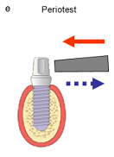
Clinical biomechanical assessment for osseointegration
PERIOTEST
Noninvasive method of assessment of osseointegration
Limitation – lack of sensitivity
Periotest value range | Interpretation
-8 to 0 | Good osseointegration
+1 to +9 | Clinical examination required
+10 to +50 | Poor osseointegration
Bone is stiffer and does not allow much deformation as compared with the soft tissues of the periodontium

Slide 30
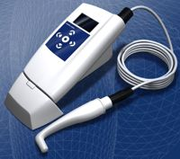
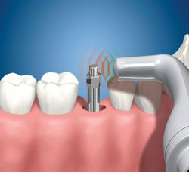
Resonance frequency analysis
L shaped transducer connected to implant to provide high frequency and amplitude of the signal received
Ostell® commercially available RFA device

Slide 31
Factors affecting osseointegration
Biocompatibility of the metal used
Design of the implant
Surface condition of the implant
The condition of the host bed
Surgical technique used
Loading condition applied
Albrektsson et al (1981)

Slide 32
SUMMARY
The osseointegration process is facilitated by a good knowledge and understanding of bone healing. Many factors can interfere with the predictable establishment of a permanent rigid connection between an implant surface and the surrounding bone that is able to sustain occlusal loads. The bone-to-implant interface and its rigidity are a predominant biomechanical aspect of coping with the time and intensity of loading

Slide 33
References-
Newman MG, Takei HH, Klokkevold PR, Carranza FA. Carranza’s clinical periodontology, 10th ed. Saunders Elsevier; 2007.
Lindhe J, Lang NP and Karring T. Clinical Periodontology and Implant Dentistry. 6th ed. Oxford (UK): Blackwell Publishing Ltd.; 2015.
Newman MG, Takei HH, Klokkevold PR, Carranza FA. Carranza’s clinical periodontology, 13th ed. Saunders Elsevier; 2018.

